Slide 1
Problem Solving by Searching

Slide 2
Outline
Introduction to graph theory
Search Problems as a general problem solver
Types of Search Strategies
Uninformed Search:
Breadth-first search
Depth first Search
Uniform cost search
Informed (Heuristic) Search
A* Search
Adversarial Search using the Min-Max technique
Conclusion

Slide 3
Graph Theory
Graph theory is a branch of mathematics highly utilized in computer science. However, graph theory has a myriad of applications in many different domains.
It is a study of graphs, where graph is a structure formed by vertices and edges connecting the vertices.
Maps, websites, communication networks, electrical circuits, program structures, …etc. are practical examples of graphs.

Slide 4
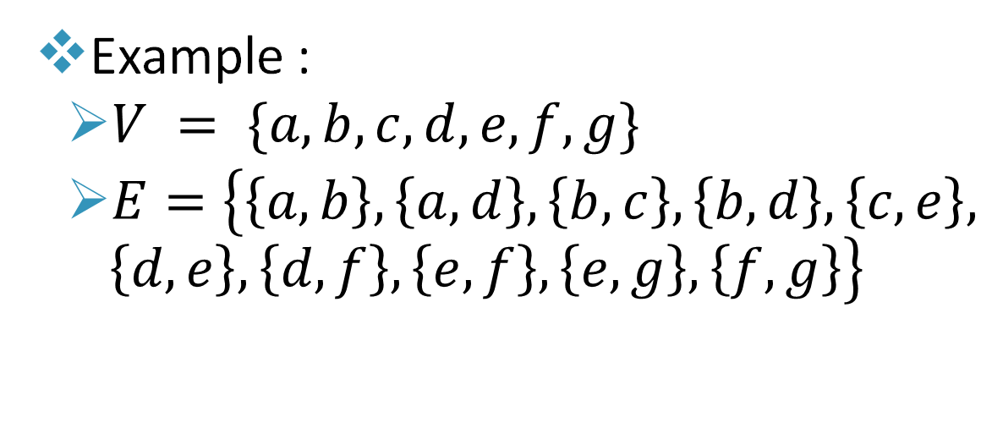
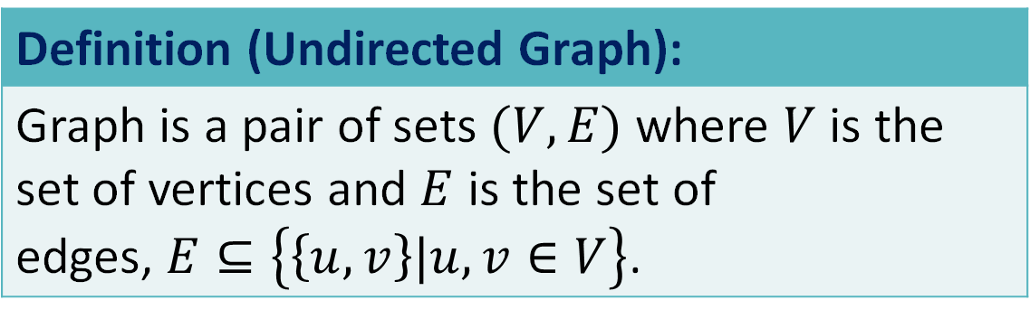
Undirected Graphs
Definition (Undirected Graph):
Graph is a pair of sets $(V, E)$ where $V$ is the set of vertices and $E$ is the set of edges, $E⊆\left\{\left\{u,v\right\}|u,v∈V\right\}$.
Example :
$V = \{a, b, c, d, e, f, g\}$
$E=\left\{\left\{a,b\right\},\left\{a,d\right\},\left\{b,c\right\},\left\{b,d\right\},\left\{c,e\right\}, \left\{d,e\right\}, \left\{d,f\right\}, \left\{e,f\right\},\left\{e,g\right\},\left\{f,g\right\}\right\}$

Slide 5
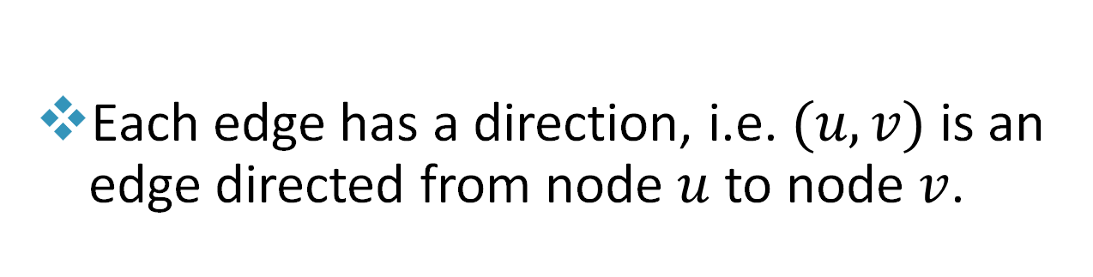
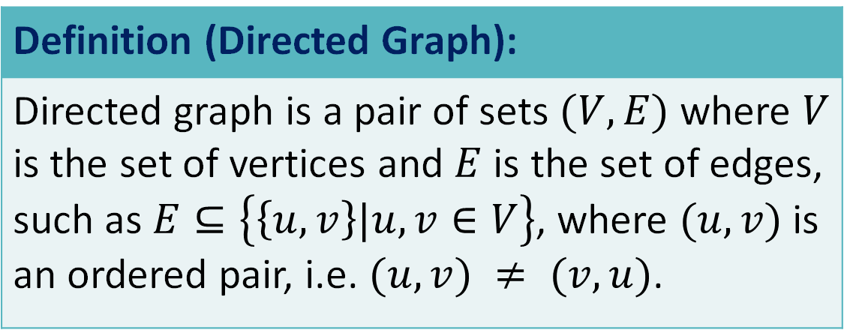
Directed Graphs
Definition (Directed Graph):
Directed graph is a pair of sets $(V, E)$ where $V$ is the set of vertices and $E$ is the set of edges, such as $E⊆\left\{\left\{u,v\right\}|u,v∈V\right\}$, where $(u,v)$is an ordered pair, i.e. $(u,v) ≠ (v,u)$.
Each edge has a direction, i.e. $(u, v)$is an edge directed from node $u$ to node $v$.

Slide 6
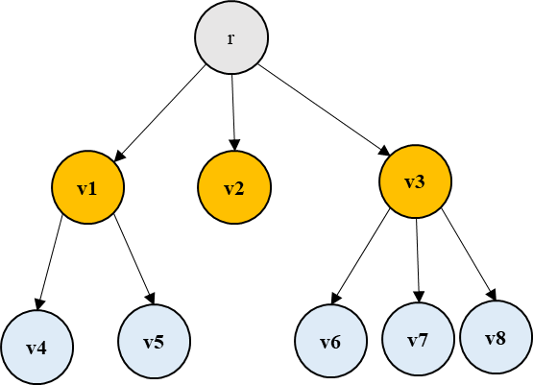
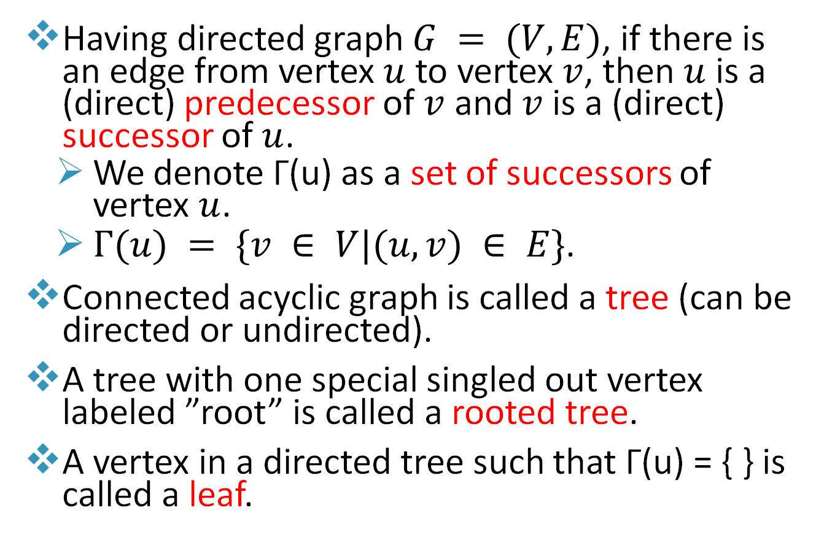
Graph Terminology
Having directed graph $G = (V, E)$, if there is an edge from vertex $u$ to vertex $v$, then $u$ is a (direct) predecessor of $v$ and $v$ is a (direct) successor of $u$.
We denote Γ(u) as a set of successors of vertex $u$.
$Γ(u) = \{v ∈ V|(u, v) ∈ E\}$.
Connected acyclic graph is called a tree (can be directed or undirected).
A tree with one special singled out vertex labeled ”root” is called a rooted tree.
A vertex in a directed tree such that Γ(u) = { } is called a leaf.

Slide 7
FIFO Queue
A FIFO Queue is a linear data structure, a list, that stores items in First In First Out (FIFO) manner.
like a line of people waiting to be served
The first element of the queue is called the head
The last element of the queue is called the tail
An element is read from the head of the queue and is written at the tail of the queue.
A FIFO queue in python can be implemented with lists (ICS 104)

Slide 8
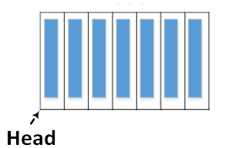
Stack
A Stack is a linear data structure, a list, that stores items in Last In First Out (LIFO) manner.
The first element of the LIFO queue (stack) is called the head
An element is read from and is written at the head of the LIFO queue (stack).
A stack in python can be implemented with lists (ICS 104)

Slide 9
Priority Queue
A priority queue is a collection of zero or more items where each item is associated with a priority.
The highest priority can be either the minimum value of all the items, or the maximum.
Inserting a new item in the priority queue must ensure that the item is placed at the right priority level.

Slide 10
Introduction to Search
Several problems can be formulated as finding a sequence of actions that lead to a desirable goal
In these problems you often start in some situation (initial state) and want to end at another (goal state)
To go from the initial state to the end state you have to take several actions
Each chosen action causes a change in the state
We want to find a subset of multiple actions to go from the initial state to the goal state
Search algorithms are general solvers for such problems

Slide 11
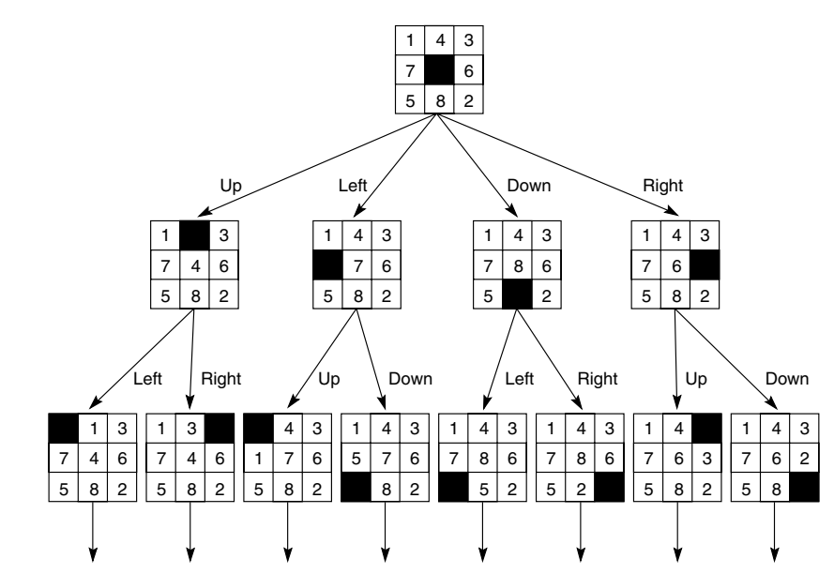
Search Problems Formulation
Problems are generally represented in terms of states (state space).
A set of all possible states that the problem can be in.
The state space is modeled as a graph G = (V , E)
state-space search is transformed to graph search
nodes are states in a problem-solving process
e.g. all the different permutations of the numbers 1,2,3,…, 8 that the 8-PUZZLE Problem can have.
4 states are shown below
Search problem
State space
Initial state
Goal state
Actions
Solution
Notes:
All examples in this chapter about finding path from a source to destination.
The objective of this example is to show the students how to solve a problem as search problems.

Slide 12
Search Problems Formulation
Example: Given a 3×3 board with 8 tiles (every tile has one number from 1 to 8) and one empty space.
The objective is to place the numbers on tiles to match the final configuration using the empty space.
Start state: the initial configuration of the problem.
e.g.
Goal state: the desired configuration of the problem
e.g.
Actions : All of the agents allowed actions
move the blank up ↑
move the blank right →
move the blank down ↓
move the blank left ←

Slide 13
Search Problems Formulation
The process of searching can be automated by applying the rules of moves to cause transitions from one state to next, until you reach to the goal state.
Solution:
A sequence of actions forms a path,
a solution is a path from initial state to a goal Path state
The state space representation of 8-PUZZLE Problem

Slide 14
AI Search Algorithms
Search Algorithms
Uninformed Search
Depth First Search (DFS)
Breadth First Search (BFS)
Informed search
A* Search
Uniform Cost Search
Adversarial Search
Min-Max

Slide 15
Search Examples
To illustrate how to solve problems by search, we will go over two types of examples
Small Map: This problem is easy to solve by looking at it which will give you an idea on how the search algorithm works
Large Map: This problem is a larger map on which you can witness different search algorithm's behavior and the difference between each search strategy

Slide 16
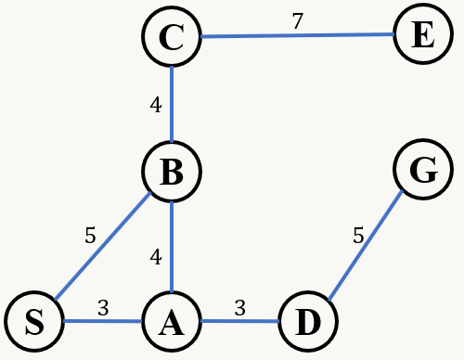
Small Map Example
Given the map on the right, starting at point 𝑆 (for Source) find a path to point 𝐺 (for Goal).
The map shows direct path connections between cities with the distance.
During search, a tree will be constructed starting with the Initial City as the root of the tree.

Slide 17
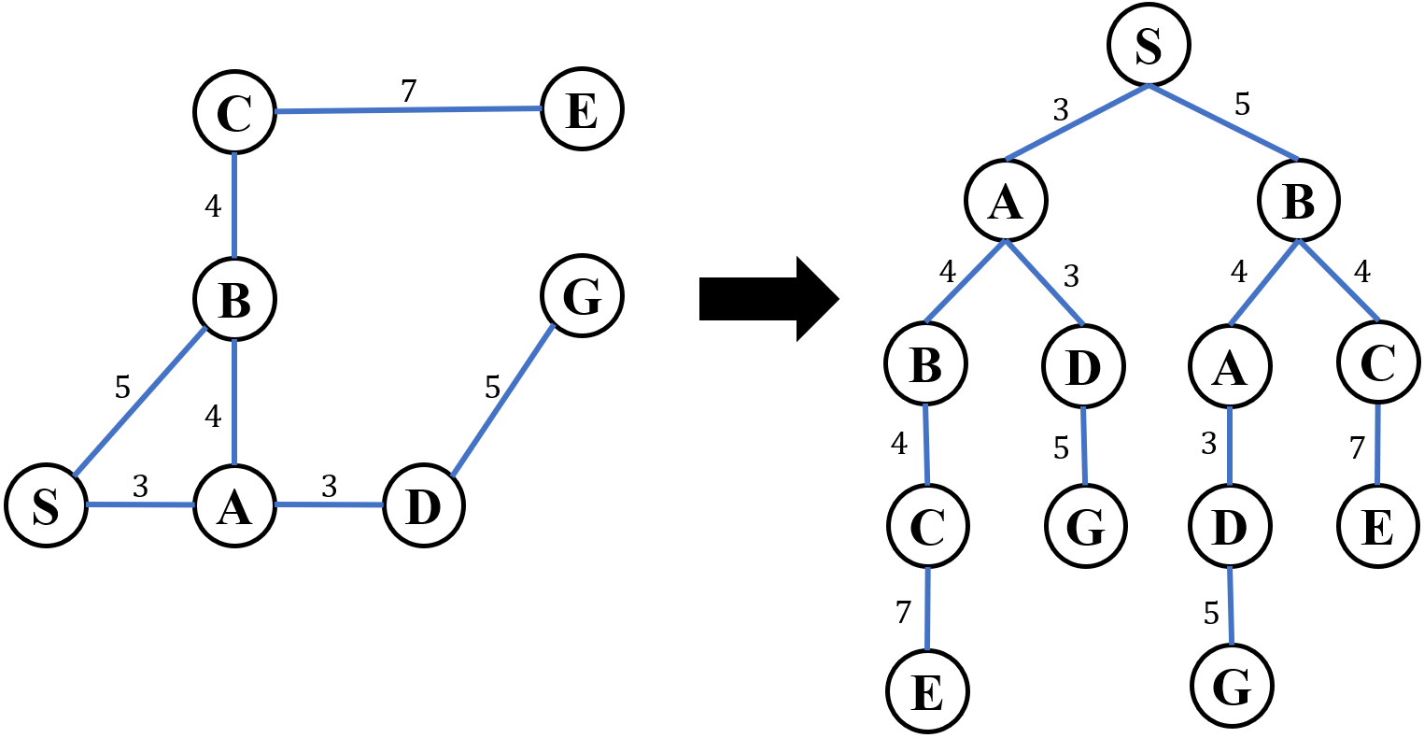
Search Solution Strategy
Additional Constraints during search tree construction:
No Cycles should be formed
When branching, order the nodes in lexical order (D on right of B but A on B's left)

Slide 18
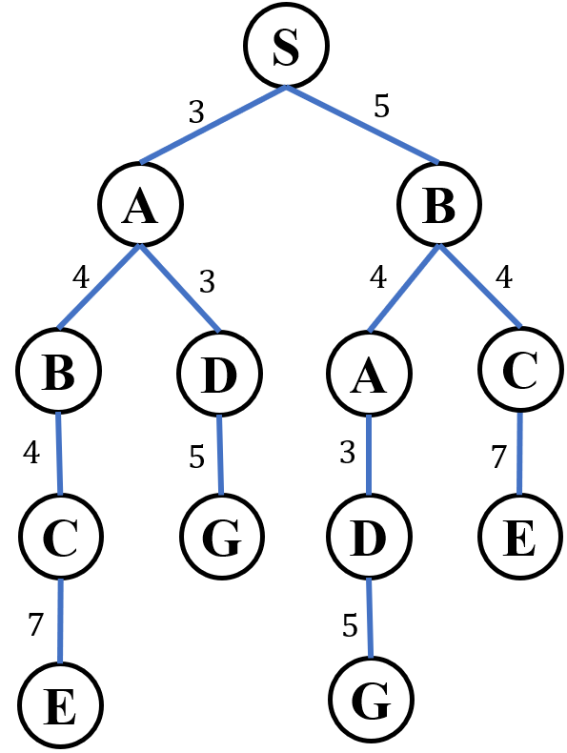
Uninformed Search - Breadth-First Search
Breadth First Search (BFS) [Definition]:
Breadth-first search is a simple strategy in which the root node is expanded first, then all the successors of the root node are expanded next, then all their successors, and so on until you find the node you are looking for.

Slide 19
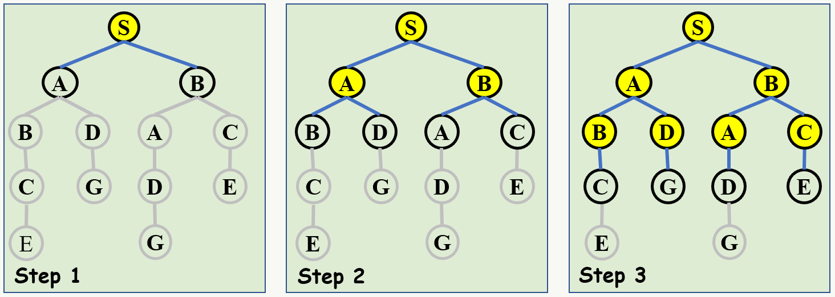
Breadth-First Search Conceptual Approach
Note the following:
Tree is generated level by level (shown in yellow nodes in each step)
Yellow node indicates that the node is expanded using an edge to its children
IN BFS, the Weights on the edges are ignored

Slide 20
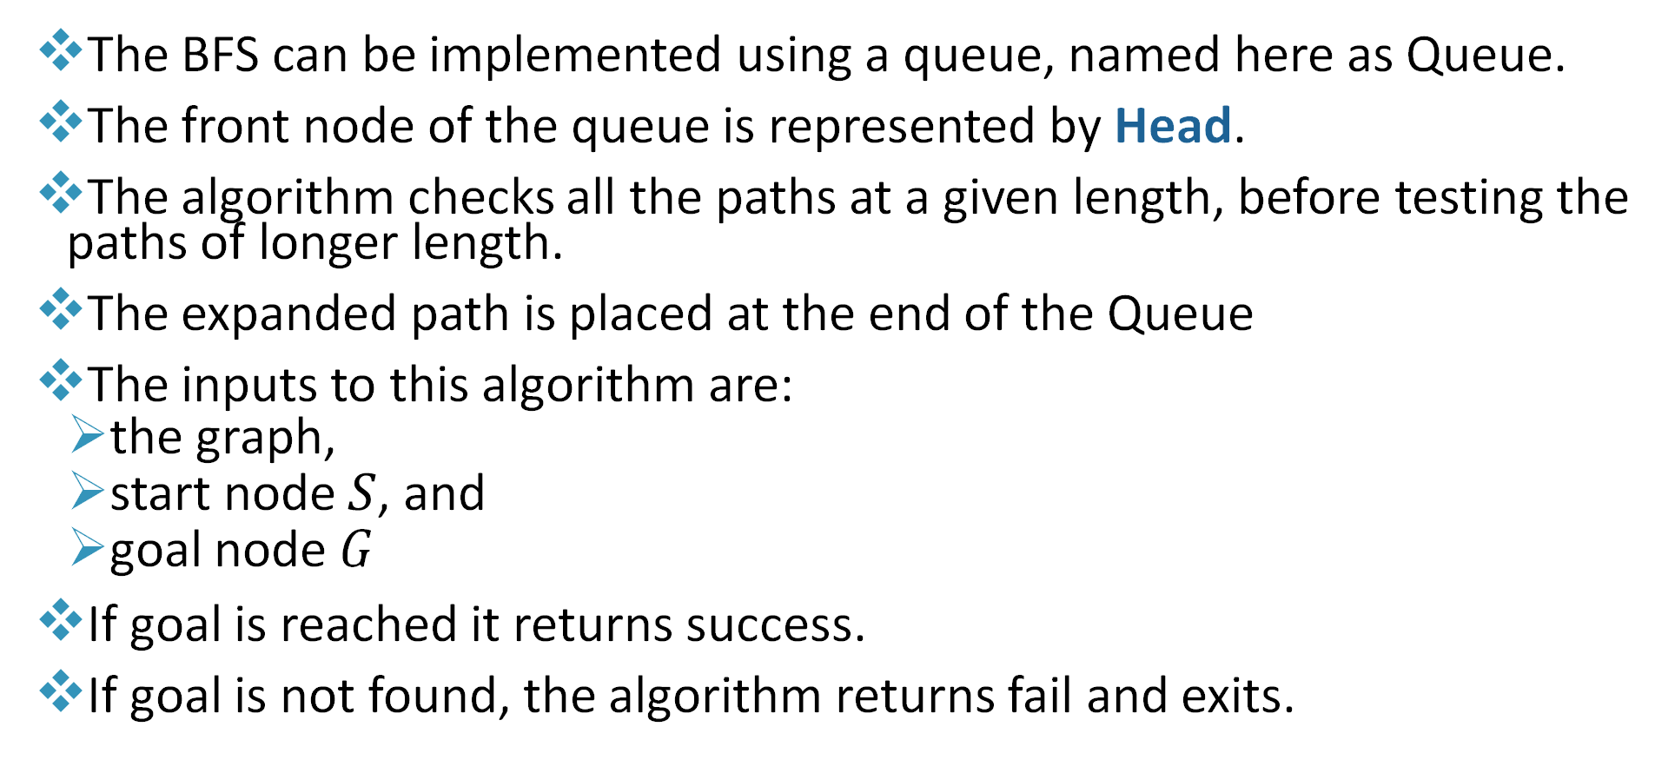
Breadth-First Search Overview
The BFS can be implemented using a queue, named here as Queue.
The front node of the queue is represented by Head.
The algorithm checks all the paths at a given length, before testing the paths of longer length.
The expanded path is placed at the end of the Queue
The inputs to this algorithm are:
the graph,
start node $S$, and
goal node 𝐺
If goal is reached it returns success.
If goal is not found, the algorithm returns fail and exits.

Slide 21
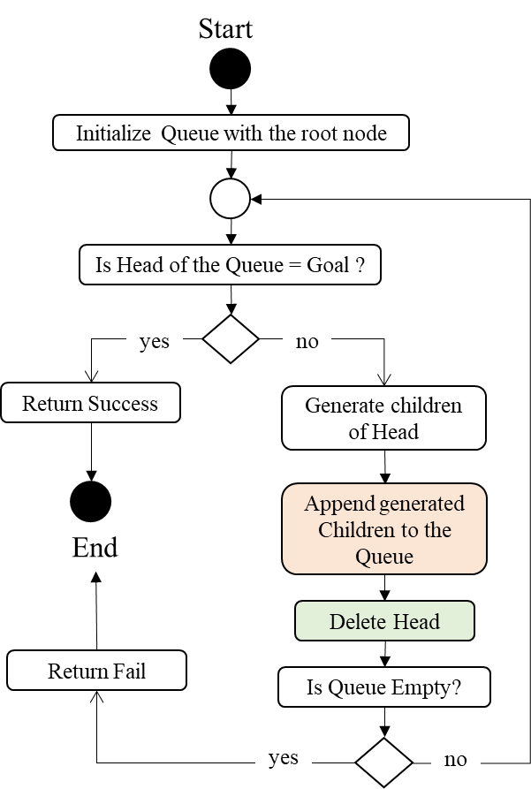
Breadth-First Search Algorithm
Algorithm: BFS (Input: Graph, S, G)
1: Queue = [S]
2: repeat
3: if Queue.Head = G then
4: return success
5: end if
6: generate children set C of Queue.Head
7: append C to Queue
8: delete Queue.Head
9: until Queue = []
10: return fail

Slide 22
Breadth-First Search Example
If the BFS is applied for this example, the content of the queue is generated as follows :
[S]
[S,A][S,B]
[S,B][S,A,B][S,A,D]
[S,A,B][S,A,D][S,B,A][S,B,C]
[S,A,D][S,B,A][S,B,C][S,A,B,C]
[S,B,A][S,B,C][S,A,B,C][S,A,D,G]
[S,B,C][S,A,B,C][S,A,D,G][S,B,A,D]
[S,A,B,C][S,A,D,G] [S,B,A,D][S,B,C,E]
[S,A,D,G][S,B,A,D][S,B,C,E][S,A,B,C,E]
Initial State is S
Goal State is G

Slide 23
Breadth-First Search Additional Example
For the graph shown, show the content of the queue when using the BFS algorithm
The content of the queue step by step is:
[S]
[S,A][S,B][S,C]
[S,B][S,C][S,A,D][S,A,E]
[S,C][S,A,D][S,A,E] [S,B,F] [S,B,G]
[S,A,D][S,A,E][S,B,F][S,B,G][S,C,G][S,C,H]
[S,A,E][S,B,F][S,B,G][S,C,G][S,C,H]
[S,B,F][S,B,G][S,C,G][S,C,H]
[S,B,G][S,C,G][S,C,H]
Initial State is S
Goal State is G

Slide 24
Properties of BFS
Since BFS always explores the shallow nodes before the deeper ones, BFS finds the shallowest path leading to the goal state.
In BFS, we reach a goal node with minimum number of edges from a source vertex.
BFS is a complete algorithm where if the goal exists in the tree, BFS will certainly find it.
BFS is more suitable for searching vertices which are closer to the given source.

Slide 25
Improvement to BFS Algorithm
Suppose that we are searching a uniform tree with each node having b successors
The root of the tree generates b nodes at the first level, each of which generates b more nodes for a total of b² nodes at the 2nd level
Suppose the solution is at level d, in which we will have b^{d} nodes
In the worst case, the solution could be the last node at level d
The current algorithm will generate b^{d+1}-b nodes before reaching the solution
If we check the node if it is a goal when generated before adding it to the queue, the algorithm will be more efficient

Slide 26
Uninformed Search - Depth-First Search
Depth-First Search (DFS)[Definition]:
Depth-first search always expands the deepest node in the current frontier of the search tree and if two nodes have the same depth take the one on the left by convention. Keep repeating until you find the node you are looking for.

Slide 27
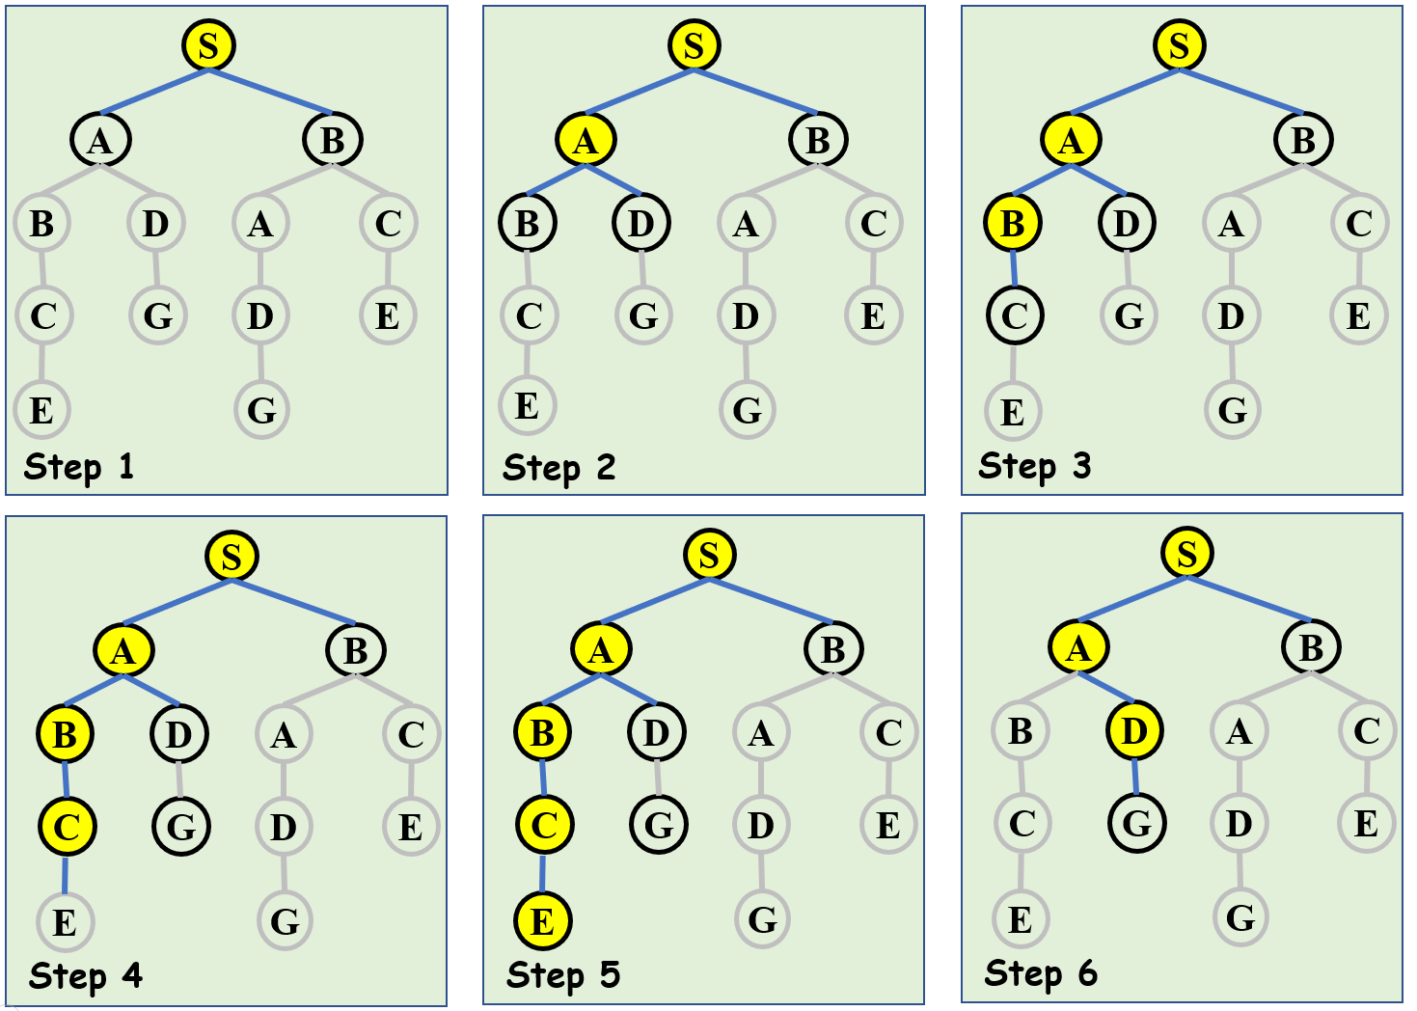
Depth Fist Search Conceptual Approach
The algorithm starts at the root node and extends each branch as far as a leaf node.
When reaching a leaf node and the goal was not found backtrack to the node closest to the leaf node where a branch exists that was not explored.
Repeat 1, 2 until goal is found or stop when there are no more nodes to explore.

Slide 28
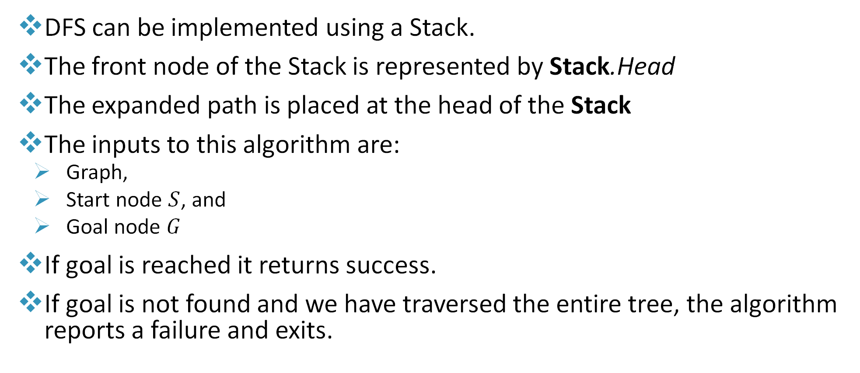
Depth First Search Overview
DFS can be implemented using a Stack.
The front node of the Stack is represented by Stack.Head
The expanded path is placed at the head of the Stack
The inputs to this algorithm are:
Graph,
Start node $S$, and
Goal node 𝐺
If goal is reached it returns success.
If goal is not found and we have traversed the entire tree, the algorithm reports a failure and exits.

Slide 29
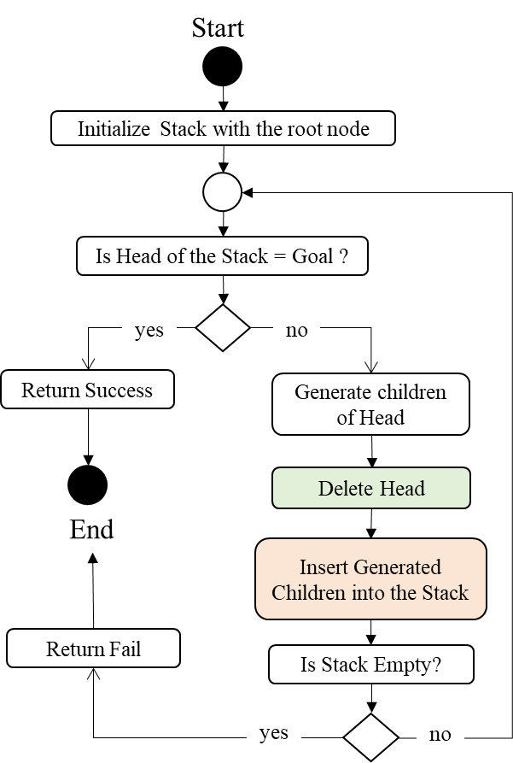
Depth First Search Algorithm
Algorithm: DFS (Input: Graph, S, G)
1: Stack = [S]
2: repeat
3: if Stack.Head = G then
4: return success
5: end if
6: generate children set C of Stack.Head
7: delete Stack.Head
8: insert C into Stack
9: until Stack = []
10: return fail

Slide 30
Depth First Search Example
If the DFS is applied for this example, the content of the stack is generated as follows :
[S]
[S,A][S,B]
[S,A,B][S,A,D][S,B]
[S,A,B,C][S,A,D][S,B]
[S,A,B,C,E][S,A,D][S,B]
[S,A,D][S,B]
[S,A,D,𝐺][S,B]
Initial State is S
Goal State is G

Slide 31
Depth First Search Additional Example
For the graph shown, show the content of the stack when using the DFS algorithm
The content of the stack step by step is:
[S]
[S,A][S,B][S,C]
[S,A,D][S,A,E][S,B][S,C]
[S,A,E][S,B][S,C]
[S,B][S,C]
[S,B,F][S,B,G][S,C]
[S,B,G][S,C]
Initial State is S
Goal State is G
Directed Graph

Slide 32
Comparison Between DFS and BFS
BFS (Breadth First Search) | DFS (Depth First Search)
BFS uses Queue data structure for reaching the goal node where the expanded node is placed at the tail of the queue. | DFS uses Stack data structure for reaching the goal node where the expanded node is placed at the Head of the stack.
BFS can be used to find single source shortest path in an unweighted graph. | In DFS, we might traverse through more edges to reach a goal node from the source node.
BFS is more suitable for searching vertices which are closer to the given source. | DFS is more suitable when there are solutions away from source.
In BFS, sibling nodes are visited before the children | In DFS, children are visited before the siblings
Ignores the edge weights | Ignores the edge weights
Note:
Sibling nodes are nodes that share the same parent.
Unweighted graphs are graphs in which the numerical weight of edge is ignored.

Slide 33
Uniform-Cost Search
Uniform-Cost Search [Definition]:
Uniform-cost search is an uninformed search algorithm for searching a weighted tree or graph that uses the lowest cumulative cost to find a path from the source to the destination. Nodes are expanded, starting from the root, according to the minimum cumulative cost. It is also named as Branch and Bound algorithm.

Slide 34
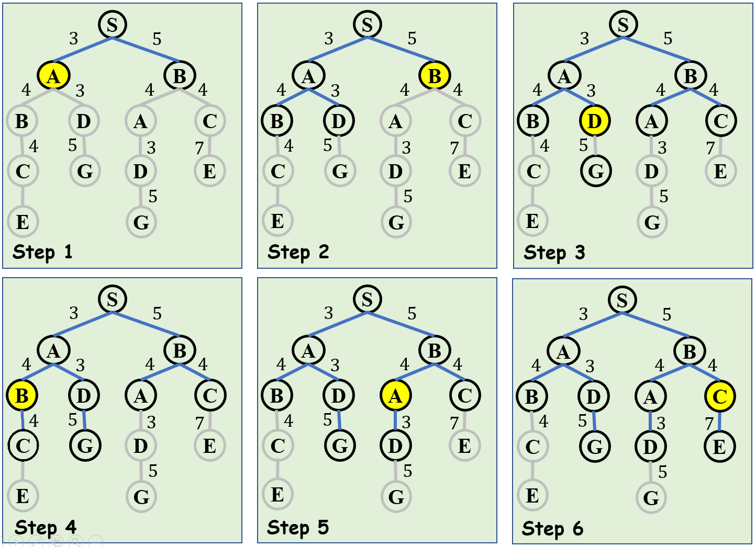
Uniform-Cost Search Conceptual Approach
It expands the node with least cost first.
Least cumulative cost is used to determine the next node to be expanded.

Slide 35
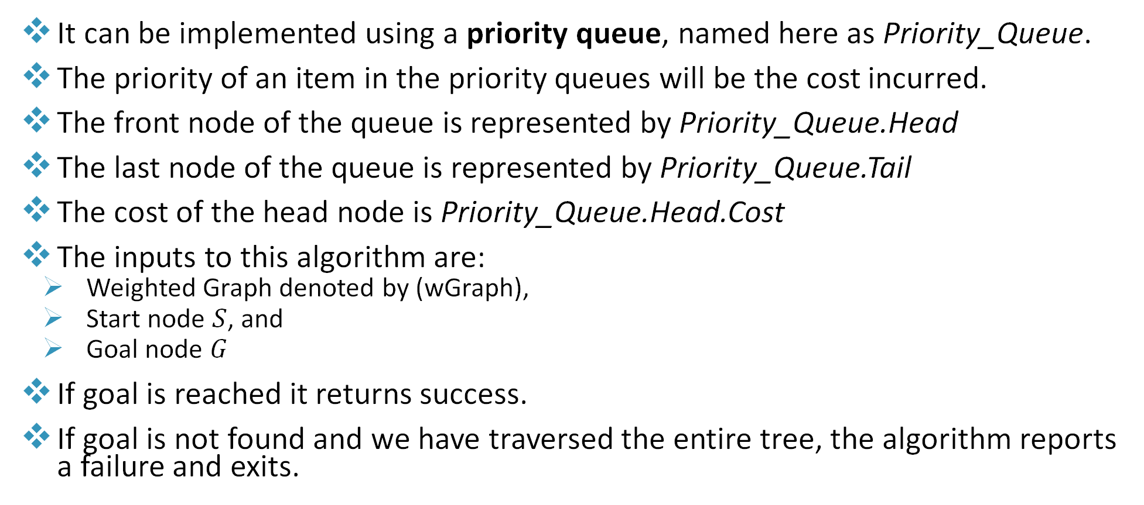
Uniform Cost Search Overview
It can be implemented using a priority queue, named here as Priority_Queue.
The priority of an item in the priority queues will be the cost incurred.
The front node of the queue is represented by Priority_Queue.Head
The last node of the queue is represented by Priority_Queue.Tail
The cost of the head node is Priority_Queue.Head.Cost
The inputs to this algorithm are:
Weighted Graph denoted by (wGraph),
Start node $S$, and
Goal node 𝐺
If goal is reached it returns success.
If goal is not found and we have traversed the entire tree, the algorithm reports a failure and exits.

Slide 36
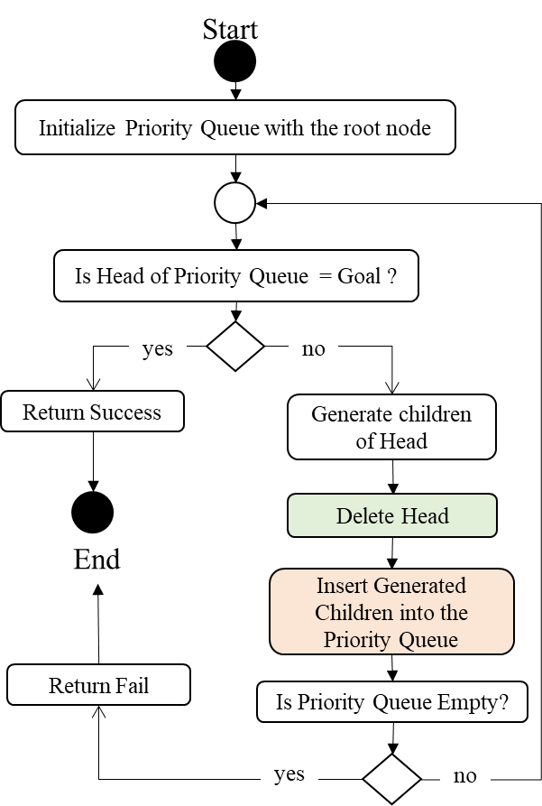
Uniform Cost Search (UCS) Algorithm
Algorithm: UCS (Input: wGraph, S, G)
1: Priority_Queue= [S]
2: repeat
3: if Priority_Queue.Head = G then
4: return success
5: end if
6: generate children set C of Priority_Queue.Head and calculate their cumulative cost
7: delete Priority_Queue.Head
8: insert C into the Priority_Queue based on the new cumulative cost
9: until Priority_Queue = []
10: return fail

Slide 37
Uniform-Cost Search using Priority Queues
1. Queue: [S]
Cost: 0
2. Queue: [S,A] [S,B]
Cost: 3 5
3. Queue: [S,B] [S,A,D] [S,A,B]
Cost: 5 6 7
4. Queue: [S,A,D] [S,A,B] [S,B,A] [S,B,C]
Cost: 6 7 9 9
5. Queue: [S,A,B] [S,B,A] [S,B,C] [S,A,D,G]
Cost: 7 9 9 11
6. Queue: [S,B,A] [S,B,C] [S,A,B,C] [S,A,D,G]
Cost: 9 9 11 11
7. Queue: [S,B,C] [S,A,B,C] [S,A,D,G] [S,B,A,D]
Cost: 9 11 11 12
8. Queue: [S,A,B,C] [S,A,D,G] [S,B,A,D] [S,B,C,E]
Cost: 11 11 12 16
9. Queue: [S,A,D,G] [S,B,A,D] [S,B,C,E] [S,A,B,C,E]
Cost: 11 12 16 18

Slide 38
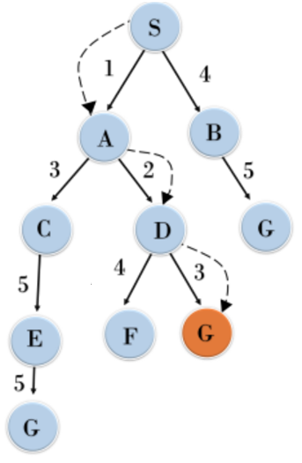
Uniform-Cost Search using Priority Queues
1. Queue: [S]
Cost: 0
2. Queue: [S,A] [S,B]
Cost: 1 4
3. Queue: [S,A,D] [S,B] [S,A,C]
Cost: 3 4 4
4. Queue: [S,B] [S,A,C] [S,A,D,G] [S,A,D,F]
Cost: 4 4 6 7
5. Queue: [S,A,C] [S,A,D,G] [S,A,D,F] [S,B,G]
Cost: 4 6 7 9
6. Queue: [S,A,D,G] [S,A,D,F] [S,A,C,E] [S,B,G]
Cost: 6 7 9 9

Slide 39
Notes on Search
Search ≠ Tree or Graph or Map
Search ≡ choice you make when you have multiple options
A tree or a graph or a map are just representations that make it easy for humans to understand

Slide 40
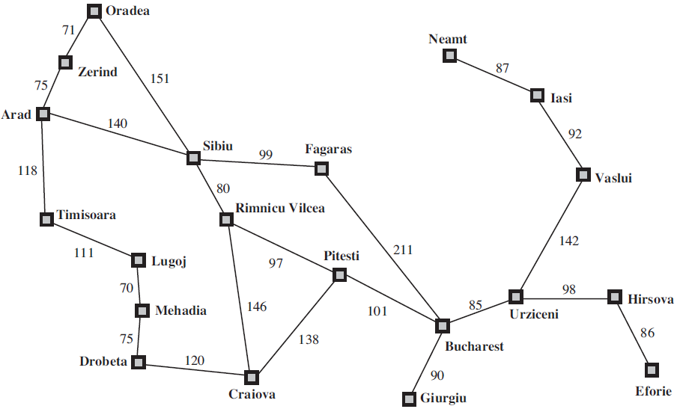
Large Map Example
Suppose you are visiting Romania and you want to go from the city Arad to the city Bucharest using a car. What is the best path to take?
Each city is represented as a node.
Each path is represented by an edge joining the respective cities.
Each path has a cost associated with it (in our example it’s the distance)
How would you tell a computer program to find a path between both cities? (this is a search problem that we will discuss)

Slide 41
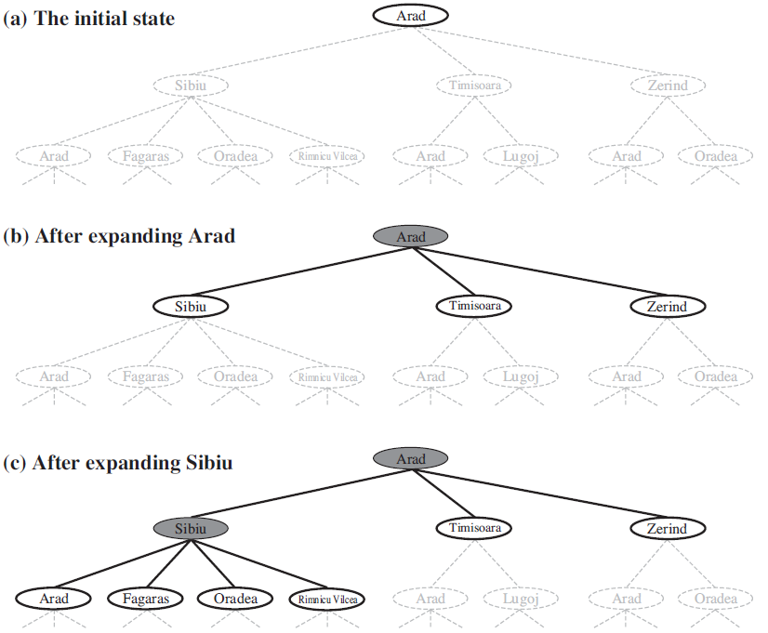
Large Map Example Solution
Ignore Redundant paths as they never add any values but rather increase cost
Redundant path is having more than one way to get from one node to another. This is achieved as follows:
For BFS and DFS, do not add a node to the queue/stack that has been either extended or in the queue/stack
For UCS, do not extend or enqueue a node that has been extended

Slide 42
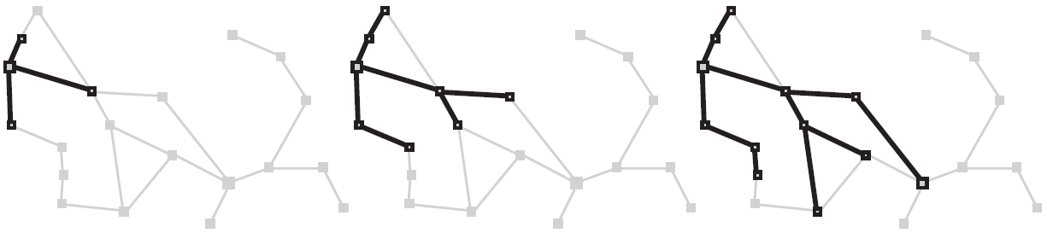
Large Map Example Solution
BFS (visual representation where tree is constructed on the map itself)
Highlighted nodes show nodes that have been added to the queue

Slide 43
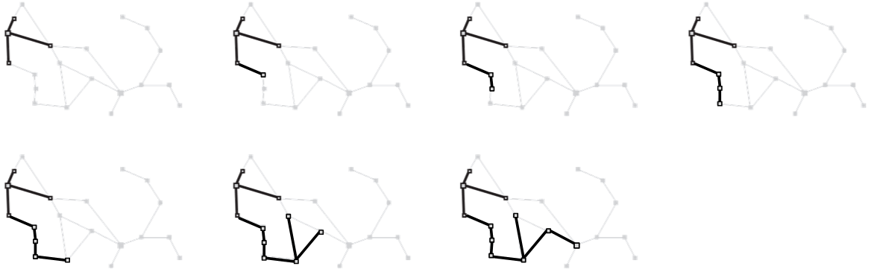
Large Map Example Solution
DFS (visual representation where tree is constructed on the map itself)
Uniform Cost Search
This exercise is left for students to perform.
Highlighted nodes show nodes
that have been added to the stack

Slide 44
Breadth-First Search avoiding Redundant Paths
If the BFS is applied for this example with the condition applied to avoid redundant paths, the content of the queue is generated as follows :
[S]
[S,A][S,B]
[S,B][S,A,D]
[S,A,D][S,B,C]
[S,B,C] [S,A,D,G]
[S,A,D,G] [S,B,C,E]
Initial State is S
Goal State is G

Slide 45
Depth First Search avoiding Redundant Paths
If the DFS is applied for this example with the condition applied to avoid redundant paths, the content of the stack is generated as follows :
[S]
[S,A][S,B]
[S,A,D][S,B]
[S,A,D,G][S,B]
Initial State is S
Goal State is G

Slide 46
Uniform Cost Search avoiding Redundant Paths
1. Queue: [S]
Cost: 0
2. Queue: [S,A] [S,B]
Cost: 3 5
3. Queue: [S,B] [S,A,D] [S,A,B]
Cost: 5 6 7
4. Queue: [S,A,D] [S,A,B] [S,B,C]
Cost: 6 7 9
5. Queue: [S,A,B] [S,B,C] [S,A,D,G]
Cost: 7 9 11
6. Queue: [S,B,C] [S,A,D,G]
Cost: 9 11
7. Queue: [S,A,D,G] [S,B,C,E]
Cost: 11 16
Note: Red nodes indicate that this node has been extended before

Slide 47
Summary of Uninformed Search
Breadth First Search Algorithm expands the search level by level, exploring all possibilities of one level before going down.
Depth First Search Algorithm starts by going down one level from the left by convention until the goal is reached. The program goes back up to the previous node if the goal is not reached, a process called “back up” or “backtracking“.
BFS and DFS may not result with the same path from the root node to goal node.

Slide 48
Summary of Uninformed Search
The big advantage of DFS is that it has much lower memory requirements than BFS, because it is not necessary to store all of the child pointers at each level.
Depending on the data and what you are looking for, either DFS or BFS could be advantageous.
Use uniform cost search when you want to find the path in a graph that takes you from the root node to some goal node with the least considered cost function.
Redundant paths can be avoided using extended list and additional condition for adding children in the queue/stack.

Slide 49
Informed Search
Heuristics are strategies often used to find a solution that is not perfect but is within an acceptable degree of accuracy for the needs of the process. Simply put it is a shortcut.
Heuristic solutions often find a good solution, not necessarily an optimal one, out of the available options.
Heuristic knowledge is the less rigorous, more experiential and more judgmental knowledge of performance or what commonly constitutes the rules of "good judgement" or the art of "good guessing" in a field.

Slide 50
Informed Search algorithms
They consider quantitative values such as heuristics while searching
Heuristics are defined in the form of a function based on the nature of the problem
Heuristic are used to make more informed decisions regarding which paths to traverse.
order the nodes to be visited such that most promising nodes are explored first
They reduce the search space
They do not follow the exhaustive search approach, making them far more efficient than the uninformed search methods

Slide 51
Heuristic Search
Heuristic search refers to a search strategy that attempts to optimize a problem by iteratively improving the solution based on a given heuristic function or a cost measure.
It makes decisions by ranking every available choice at each branch of a search and then chooses the best option of those presented.
Heuristic approach emphasizes speed over accuracy, and therefore finds the most acceptable option within a reasonable time limit or within the allocated memory space.
A heuristic function is said to be admissible if it never overestimates the cost of reaching the goal, i.e., the estimated cost to reach the goal is not higher than the lowest possible cost from the current point in the path(i.e. a lower bound)

Slide 52
Informed Search - A* Search
A* Search is a search method that minimizes the total estimated solution cost
The A* search is composed of the following:
Uniform Cost Search (also known as Branch and Bound)
Extended List
Admissible Heuristics

Slide 53
Avoiding Redundant Paths in A*
The same as uniform cost search with the following enhancement:
If you reach a node that was extended before with lower or equal cost, do not extend it and discard it because you already reached this node using some other path with less or equal cost
Do not enqueue a node that has been previously extended with lower or equal cost.
Note that these two conditions are the ones used to avoid redundant paths in UCS and the added condition “with lower or equal cost” is required due to the use of admissible heuristics

Slide 54
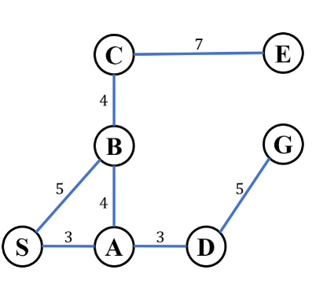
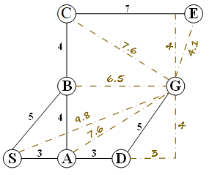
A* Search
First look for a good heuristic that takes you closer to the goal
In a map the Euclidean distance to the goal is a good heuristic (shown as dashed lines)
Use the heuristic to expand the node that leads you closer to the goal
like Uniform Cost Search with the difference that weight of the node has the admissible heuristics included

Slide 55
A* Search
The estimated remaining distance to the goal is added to the extended path.
Only the shortest (path extended + remaining estimated distance) is extended until the goal is reached.
All longer paths are discarded.
The white color nodes indicate enqueued nodes

Slide 56
A* Search – Example 1
1. Queue: [S]
Cost: 9.8
2. Queue: [S,A] [S,B]
Cost: 10.6 11.5
3. Queue: [S,A,D] [S,B] [S,A,B]
Cost: 11 11.5 13.5
4. Queue: [S,A,D,G] [S,B] [S,A,B]
Cost: 11 11.5 13.5

Slide 57
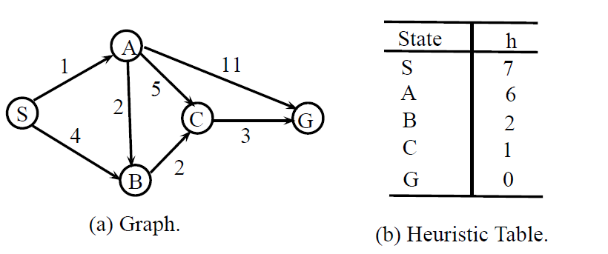
A* Search – Example 2
Consider the graph shown below and the heuristic table showing the used heuristic function

Slide 58
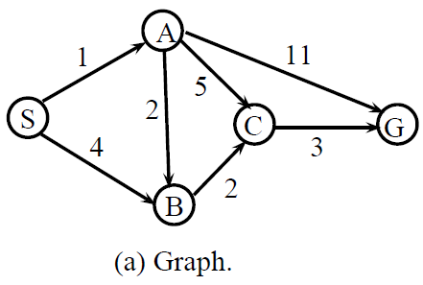
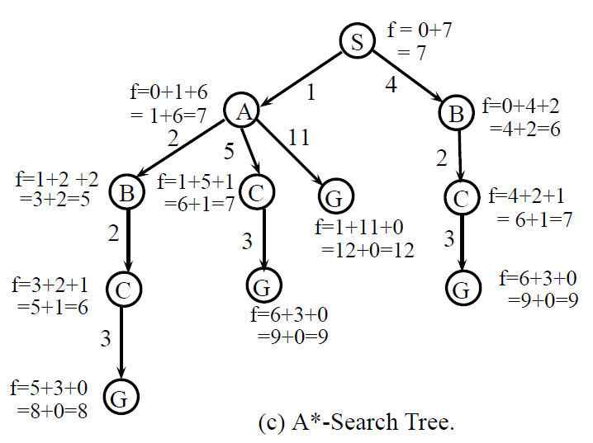
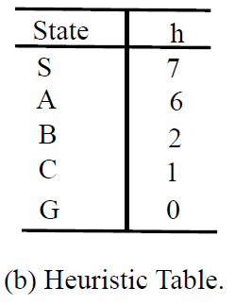
A* Search – Example 2
1. Queue: [S]
Cost: 7
2. Queue: [S,B] [S,A]
Cost: 6 7
3. Queue: [S,A] [S,B,C]
Cost: 7 7
4. Queue: [S,A,B] [S,A,C] [S,B,C] [S,A,G]
Cost: 5 7 7 12
5. Queue: [S,A,B,C] [S,A,C] [S,B,C] [S,A,G]
Cost: 6 7 7 12
6. Queue: [S,A,C] [S,B,C] [S,A,B,C,G] [S,A,G]
Cost: 7 7 8 12
7. Queue: [S,B,C] [S,A,B,C,G] [S,A,G]
Cost: 7 8 12
8. Queue: [S,A,B,C,G] [S,A,G]
Cost: 8 12

Slide 59
A* Search
Properties of A* search:
If a solution exists for the given problem, the first solution found by A* is an optimal solution.
A* is also complete algorithm, meaning if a solution exists, the answer is bound to be found in a finite amount of time.
Advantages of A* Search | Disadvantages of A* Search
It is optimal search algorithm in terms of heuristics | This algorithm is complete if the branching factor is finite, and every action has fixed cost
It is one of the best heuristic search techniques
It is used to solve complex search problems | The performance of A* search is dependent on accuracy of heuristic algorithm used
There is no other optimal algorithm guaranteed to extend fewer nodes than A*

Slide 60
Large Map with A*
Find the optimum path between Arad and Bucharest using A*
City | Distance to Bucharest | City | Distance to Bucharest
Arad | 366 | Mehadia | 241
Bucharest | 0 | Neamt | 234
Craiova | 160 | Oradea | 280
Drobeta | 242 | Pitesti | 100
Eforie | 161 | Rimnicu Vilcea | 193
Fagaras | 176 | Sibiu | 253
Giurgiu | 77 | Timisoara | 329
Hirsova | 151 | Urziceni | 80
Iasi | 266 | Vaslui | 199
Lugoj | 244 | Zerind | 374
The distance between cities is calculated using great circle distance, which is the shortest distance between two points on the surface of a sphere.

Slide 61
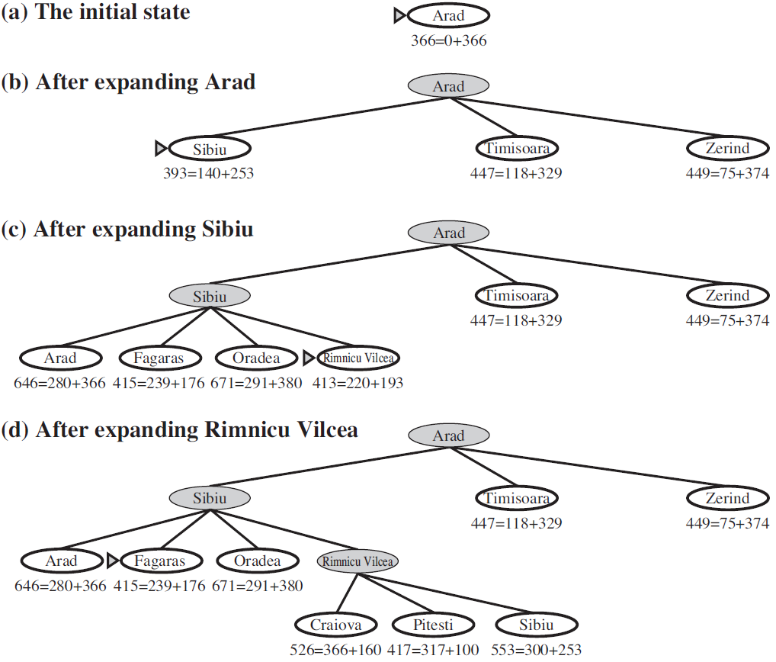
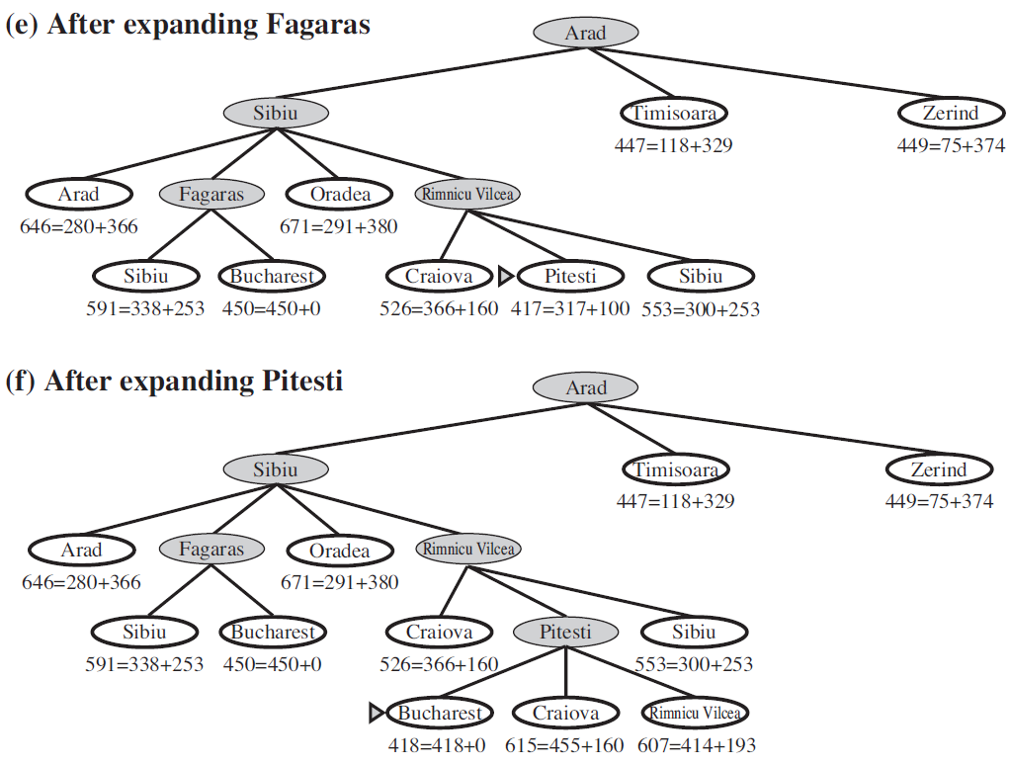
Solution of the Large Map Problem

Slide 62
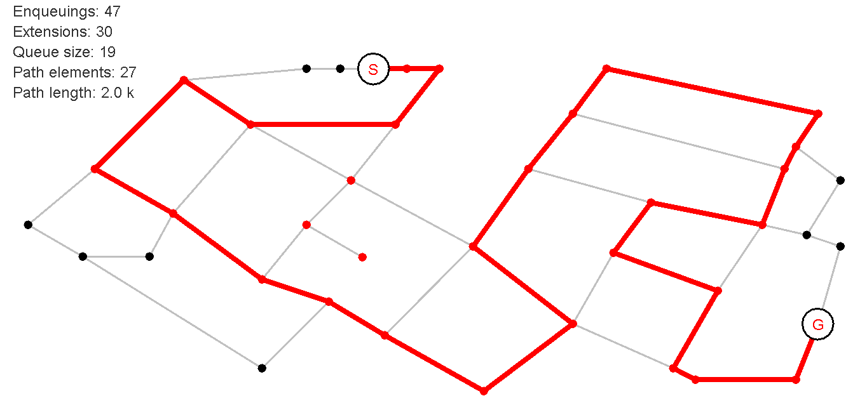
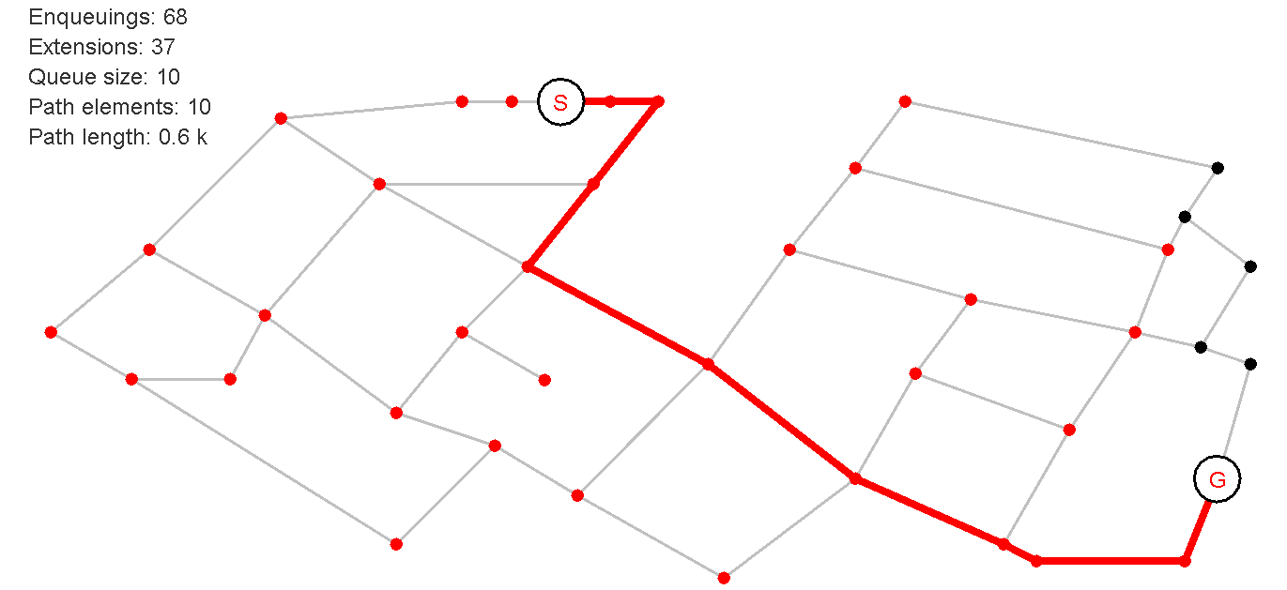
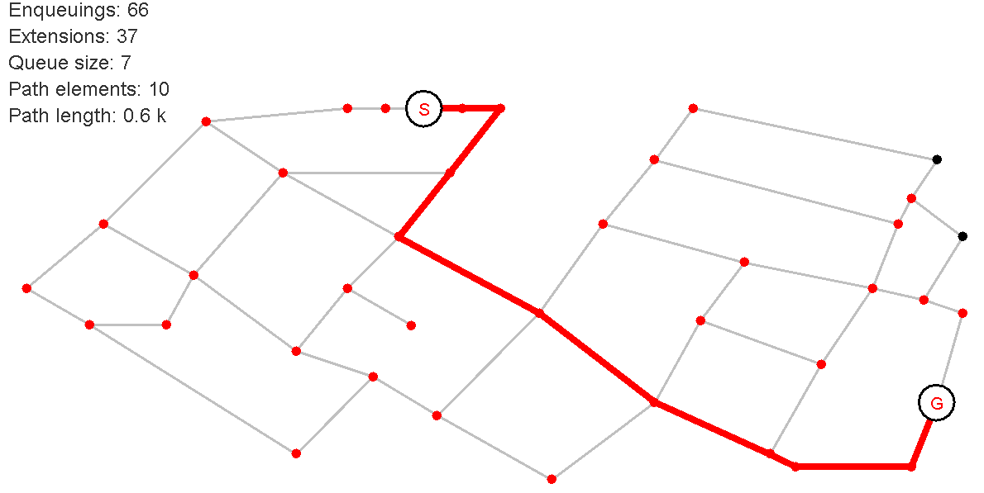
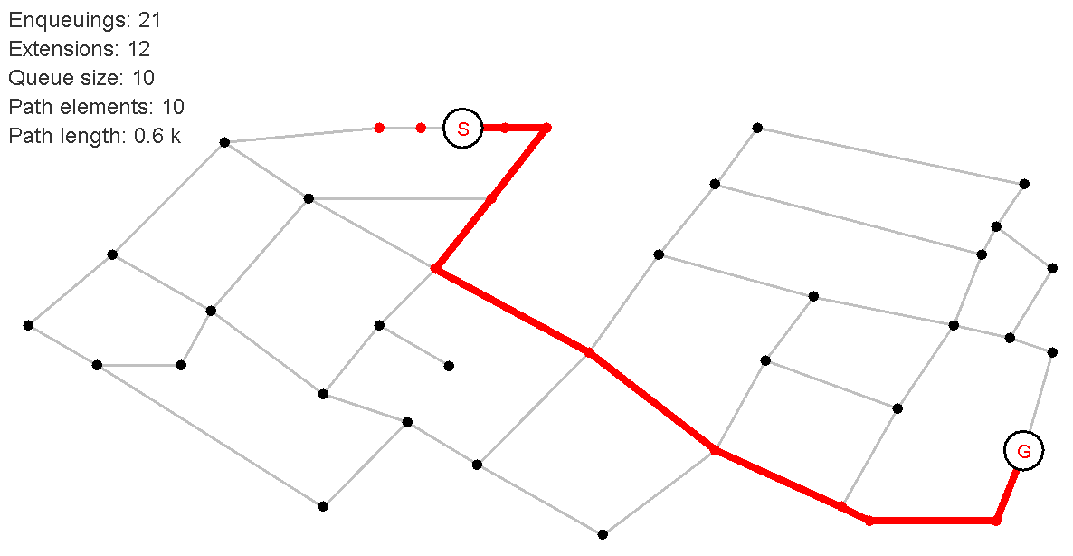
Comparison Between Search Algorithms
DFS
BSF
DFS BFS
Uniform Cost Search + Extended List
A*

Slide 63

Adversarial Search
In Adversarial search, we tackle problems that arise when we try to plan in a world were other agents are playing against us.
We want intelligent agents to play games such as Tic-Tac-Toe or chess.
How humans play the game?
mixing analysis, strategy, tactics to choose a move
Programming an agent to be intelligent we need to:
Use some sort of If-Then rules (construct a tree)
Look ahead and evaluate (as far as possible)
Reduce the search space (branch and bound)
How will we make the computer choose so that it can win?

Slide 64
Adversarial Search
A game can be formally defined as a kind of search problem as follows:
Initial state: initial board position + whose move it is
Operators: legal moves a player can make
Goal (terminal test): game over?
Utility function (payoff): measures the outcome of the game and its desirability
Search objective:
Find the sequence of player’s decisions (moves) maximizing its utility (payoff)
Consider the opponent’s moves and their utility

Slide 65
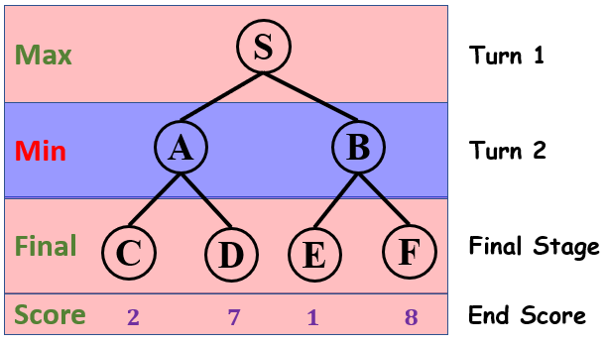
Mini-max – Toy Example
Mini-max is a kind of backtracking algorithm that is used in decision making and game theory to find the optimal move for a player, if your opponent also plays optimally.
Consider a game which has 4 final states and paths to reach from root of a tree as shown.
Terminal values: part of the game

Slide 66
Mini-max - Toy Example
Best Strategy
If the Max player chooses A, then the Min player will choose C (Utility of 2)
If the Max player chooses B, then the Min Player will choose E (Utility of 1)
Obviously, the Max player will choose A to get 2, that is greater than 1 if he chooses B.
How will you tell the computer to do this?
The Minimax algorithm tries to predict the opponent's behavior.
It predicts that the opponent will take the worst action from our viewpoint.

Slide 67
Mini-max - Toy Example
An agent strategy will be:
Go from bottom-up ↑
Min player
Utility(A) = min(C,D) = min(2,7) = 2
Utility(B) = min(E,F) = min(1,8) = 1
Max player
Utility(S) = max(A,B) = max(2,1) = 2
Decision of Max player is to choose node A

Slide 68
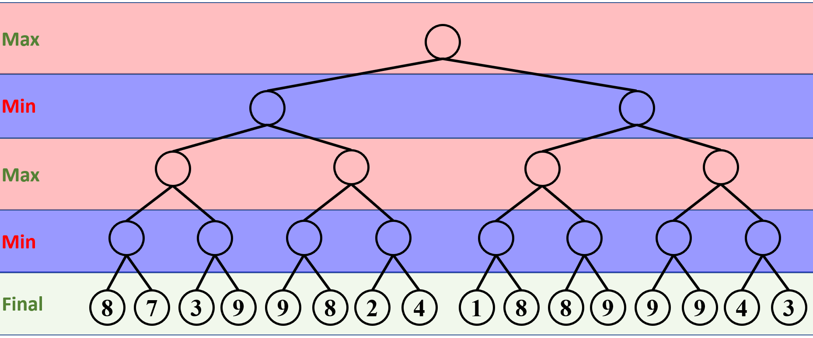
Mini-max – Large Example
Let's take a game with a bigger tree:
Utility

Slide 69
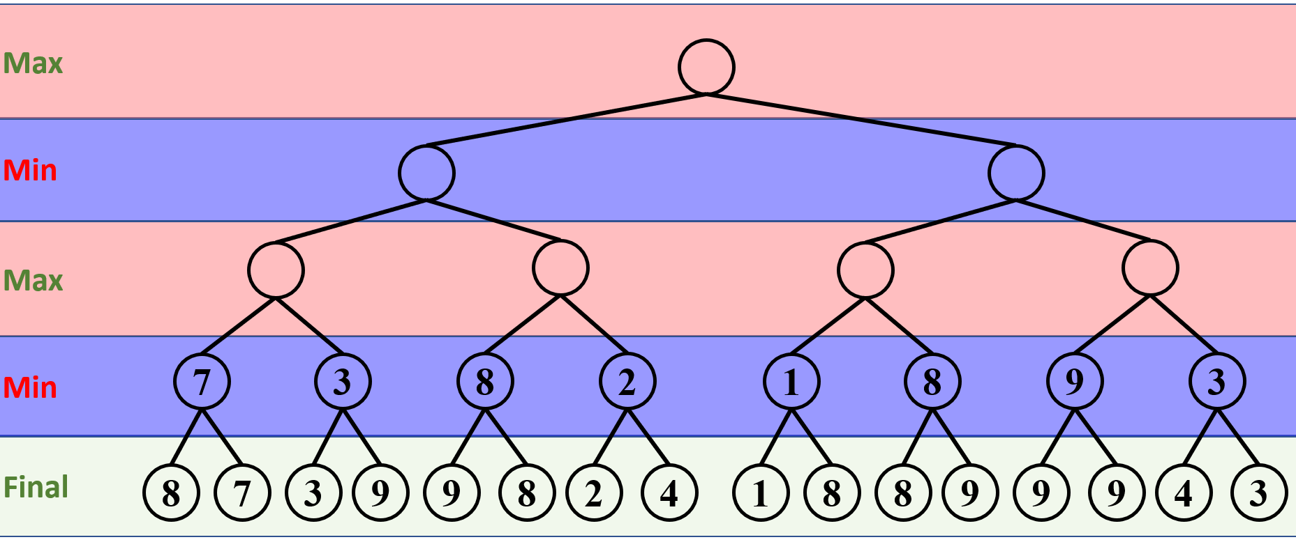
Mini-max – Large Example
From the tree, the minimizer will have the last step and attempt to minimize final “Utility”

Slide 70
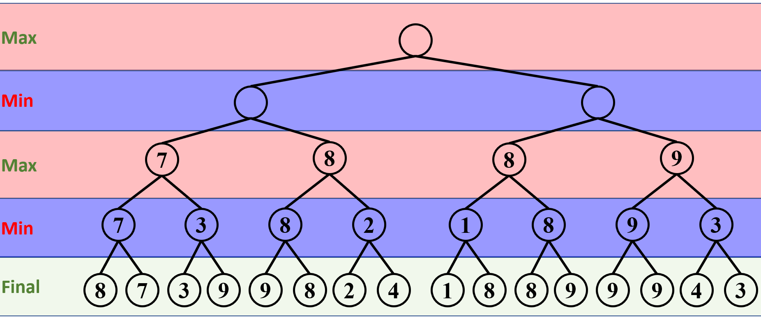
Mini-max – Large Example
The maximizer will go next and attempt to maximize the final “Utility”

Slide 71
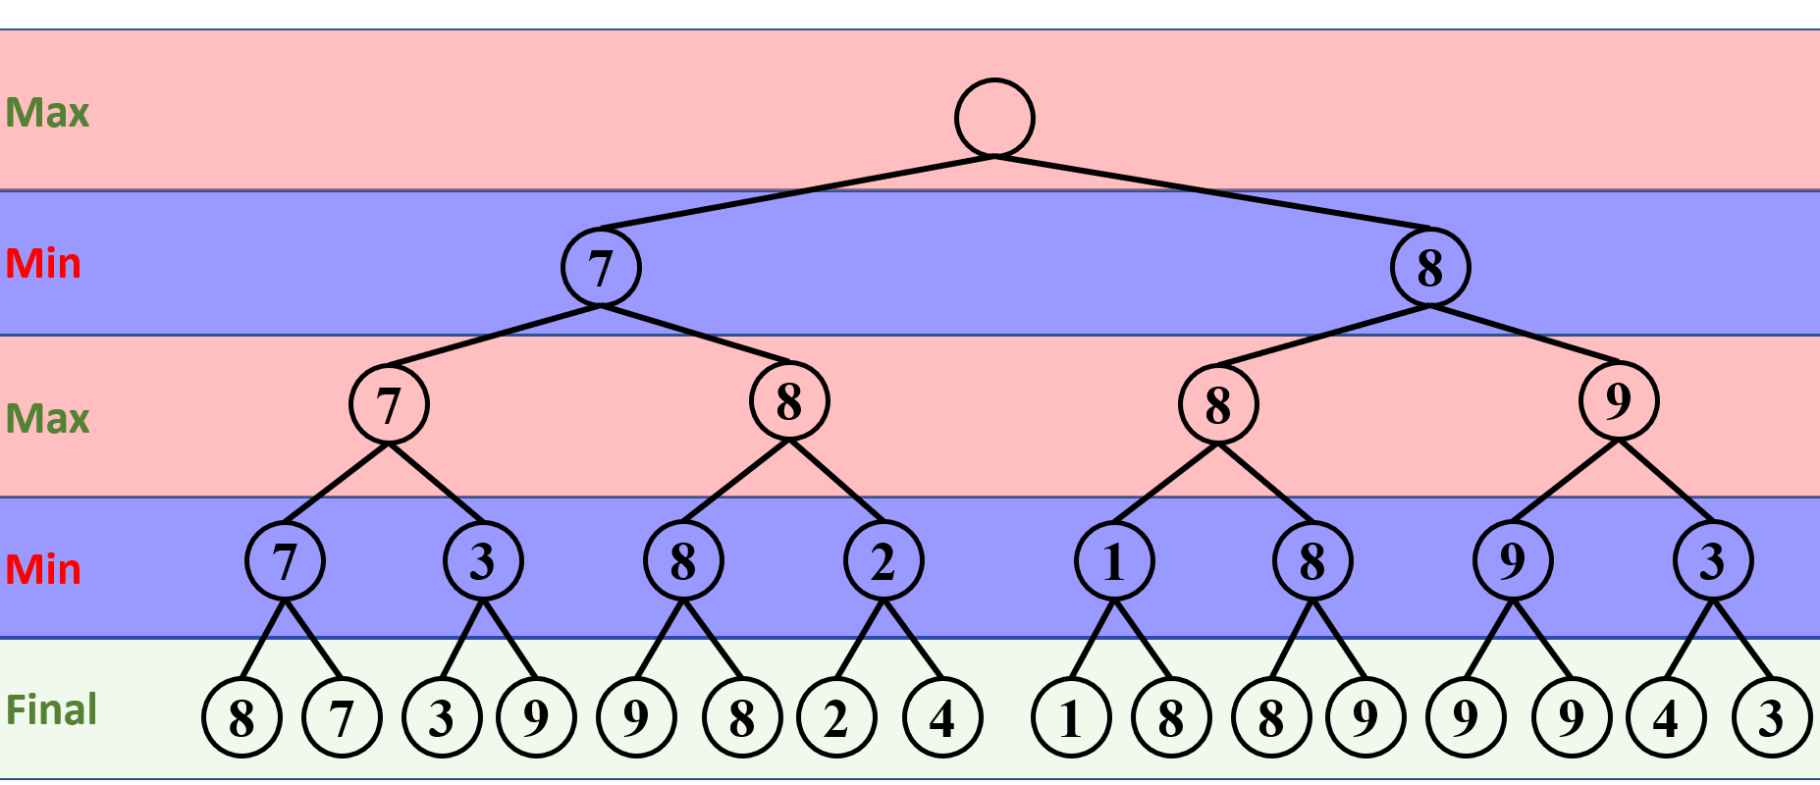
Mini-max – Large Example
The minimizer will get the second chance and attempt to minimize the final “Utility”

Slide 72
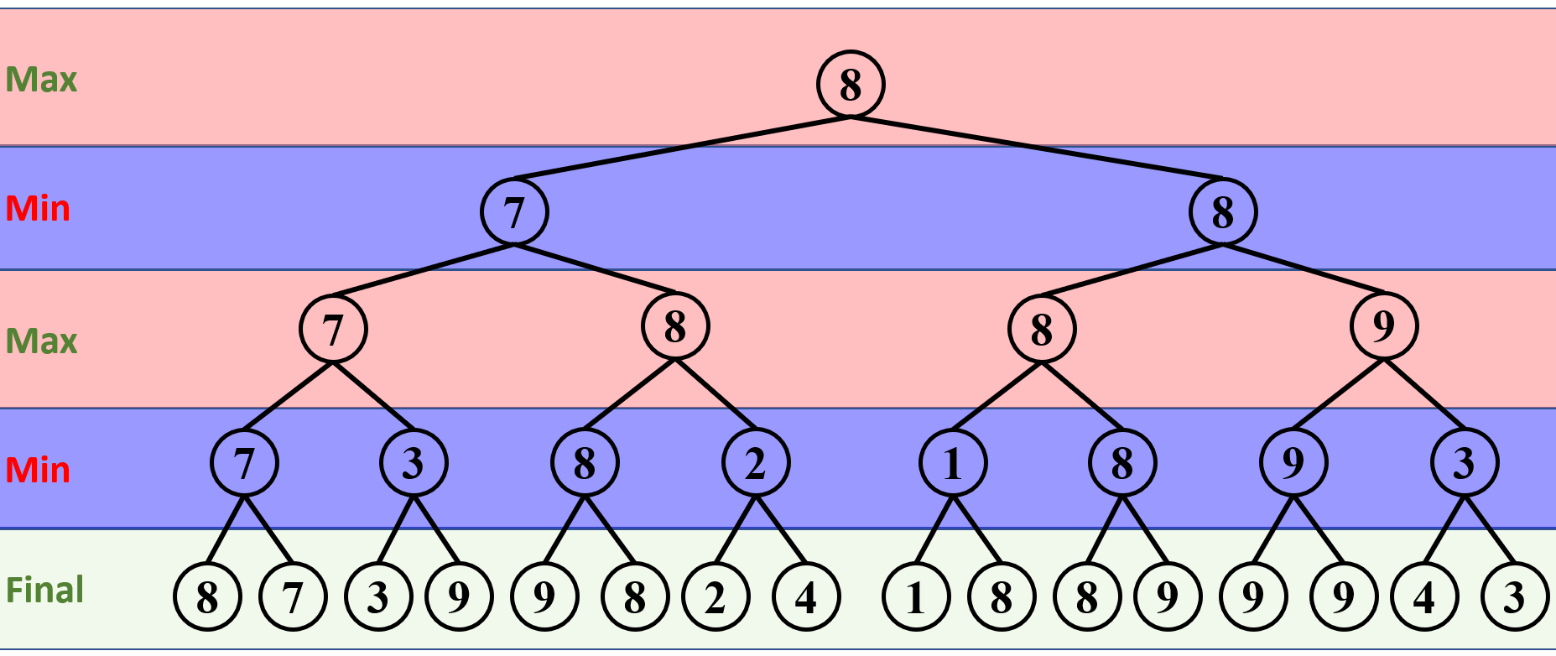
Mini-max – Large Example
Finally, the maximizer will attempt to maximize the “Utility”

Slide 73
Mini-max – Large Example
Therefore, the Mini-max algorithm will take the following path:

Slide 74
Mini-max Algorithm Pseudocode
function minimax(node, depth, maximizingPlayer) is
if depth = 0 or node is a terminal node then
return the heuristic value of node
if maximizingPlayer then
value := −∞
for each child of node do
value := max(value, minimax(child, depth − 1, FALSE))
return value
else (* minimizing player *)
value := +∞
for each child of node do
value := min(value, minimax(child, depth − 1, TRUE))
return value
Depth is the maximum depth that the algorithm needs to traverse
(* Initial call *)
minimax(origin, depth, TRUE)

Slide 75
Tic-Tac-Toe Game
A game in which two players alternately put Xs and Os in compartments of a figure formed by three vertical lines crossing three horizontal lines and each tries to get a (row, column, diagonal) of three Xs or three Os before the opponent does.
The tree of the game can be constructed as shown

Slide 76
Mini-max Technique for Tic-Tac-Toe
Let us define the following
If I win, I get 10 points (+10)
If I lose, I lose 10 points (-10)
If the game is a tie, then I get no points (0)
What is the objective of the game?
I get the maximum Utility (points) (+10)
My opponent gets the minimum Utility (points) (-10)
How would the game go?
Starting Agent (x) will try to maximize his Utility
In the second turn, the opponent Agent (o) will try to minimize the utility of the starting agent (x)

Slide 77
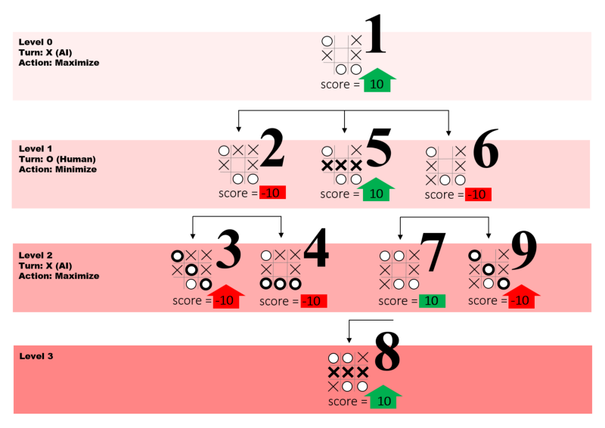
Tic-Tac-Toe
Number of vertices in the tree is bounded by 9! (since there are 9 possible ways of placing the first mark, 8 remaining ways of placing the second, 7 the third, ..., and 1 in the last. This would be 9! = 362880.
Number of Actual games that can be played = 255,168 games (not all games need to fill all 9 blocks)
A subtree of the game is shown.

Slide 78
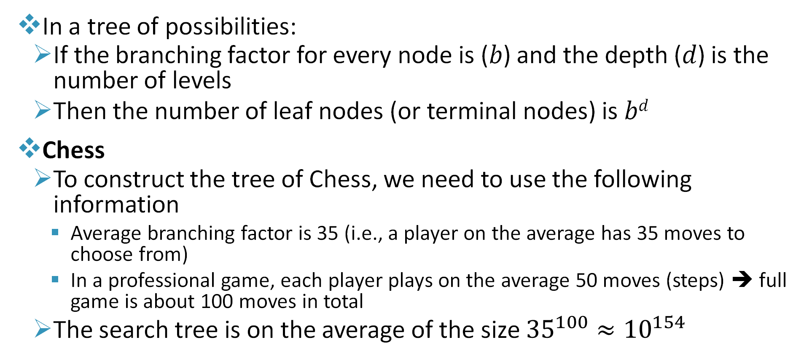
Notion of Complexity
In a tree of possibilities:
If the branching factor for every node is (𝑏) and the depth (𝑑) is the number of levels
Then the number of leaf nodes (or terminal nodes) is 𝑏^{𝑑}
Chess
To construct the tree of Chess, we need to use the following information
Average branching factor is 35 (i.e., a player on the average has 35 moves to choose from)
In a professional game, each player plays on the average 50 moves (steps) ➔ full game is about 100 moves in total
The search tree is on the average of the size ${35}^{100}≈{10}^{154}$

Slide 79
Notion of Complexity
Can we make a tree this big?
Can a supercomputer find an optimal path in this tree?
Can we utilize cloud computing to solve the problem?
Let us take a professional Chess game with average tree of 10¹⁵⁴
Lets get the notion of how long will this take to compute using some information that we know. To do this we need the following information:
How many Atoms are there in our known Universe?
How many nanoseconds are there in a year?
What is the age of the known universe?
10⁸²
3×10¹⁶≈10¹⁶
≈10¹⁰

Slide 80
Notion of Complexity
If each atom did a calculation every nanosecond from the start of the known universe till today, the number of computations will be:
Number of Atoms × Number of nanosecond per year × Age of the universe ≈ 10⁸²×10¹⁶×10¹⁰=10¹⁰⁸
We will be 10⁴⁶ times short
Do you still think that any human made system can do the calculations?
Use techniques to cut down the search space
People are also looking for Quantum Computing (maybe it can perform such computations in a reasonable amount of time)

Slide 81
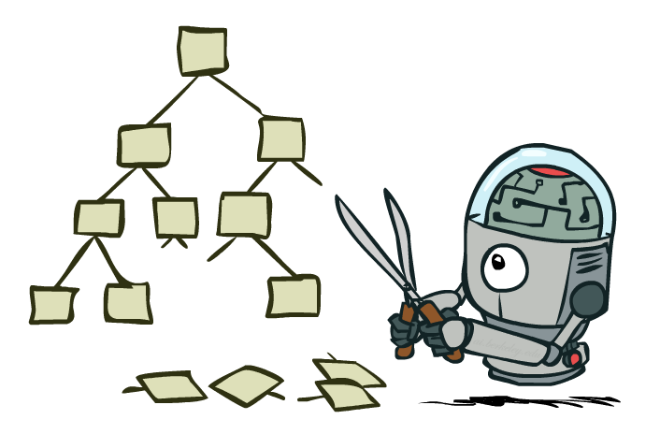
Notion of Complexity
How did “Deep Blue” system beat the world champion if we cannot compute the values in the entire Mini-Max tree?
Answer: It uses tree pruning and depth-limited search.
Pruning: is a data compression technique in machine learning and search algorithms that reduces the size of decision trees by removing sections of the tree that are non-critical and redundant to classify instances.

Slide 82
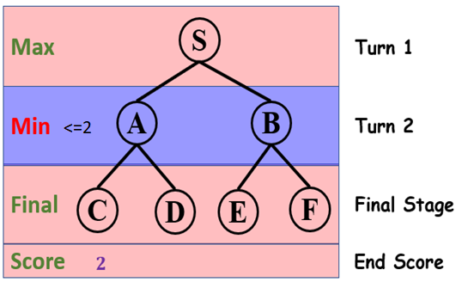
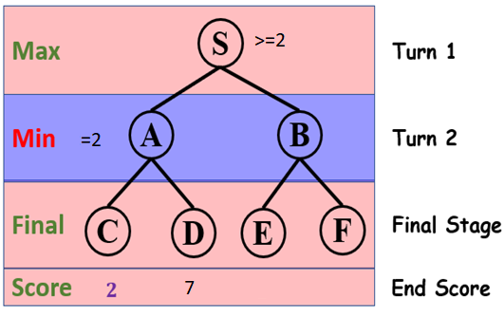
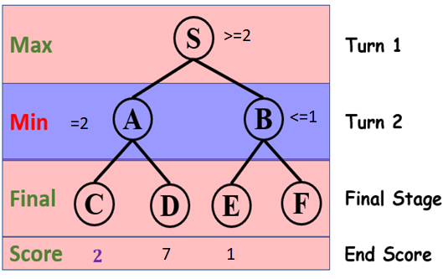
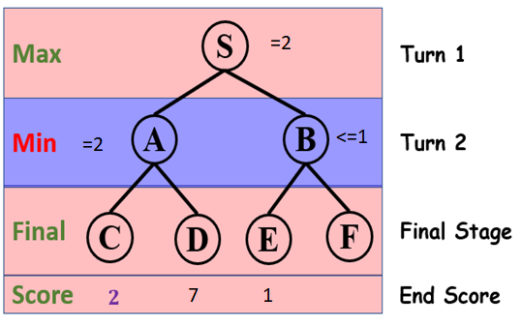
Example on Cutting the Search Space
No need to compute

Slide 83

Depth-Limited Search
Depth-limited search is like depth-first search with a predetermined limit.
It can solve the drawback of the infinite path in the depth-first search.
In Depth-limited search algorithm, the node at the depth limit will be treated as if it has no successor nodes further.
Advantages:
Depth-limited search is Memory efficient.
Disadvantages:
Depth-limited search is incomplete.
It may not be optimal if the problem has more than one solution.
https://www.javatpoint.com/ai-uninformed-search-algorithms

Slide 84

Resource Limits
Problem: In realistic games, cannot search to leaves!
Solution: Depth-limited search
Instead, search only to a limited depth in the tree
Replace terminal utilities with an evaluation function for non-terminal positions
Guarantee of optimal play is gone

Slide 85

Evaluation Functions
Evaluation functions score non-terminals in depth-limited search
Ideal function: returns the actual minimax value of the position
In practice: typically weighted linear sum of features:
e.g. f1(s) = (num white queens – num black queens), etc.

Slide 86
Conclusion
Search is a powerful tool to solve problems where we want to find series of actions to reach to a goal.
A tree is a good tool to visualize search but that does not mean that we cannot perform search without a tree.
We often revert to Uninformed search in problems we do not have any prior information about.
Informed search leverages past knowledge to solve a problem.
Adversarial search examines problems that arise when we try to plan in a world where other agents are planning against us.

